Slide 1
EagleSat 2 – Scientific Payloads’ Objectives and Developments
Presented by: Jason Hamburger – Former Space Debris Payload Lead
In cooperation with: Dr. Gary Yale, Hilliard Paige, and Lauren Barthenheier
26th Arizona Space Grant Symposium
Tempe, Arizona
April 22nd 2017

Slide 2
Outline
Cosmic Ray Payload (CRP)
  Mission Outline
  Sensor and Operation
  Cycle Definition
Radiation RAM (RAD RAM)
  Mission Outline
  Cycle Definition
  Software Algorithm
Space Debris Payload (SDP)
  Mission Outline
  Cycle Definition
  Removal

Slide 3
Cosmic Ray Payload (CRP)

Slide 4
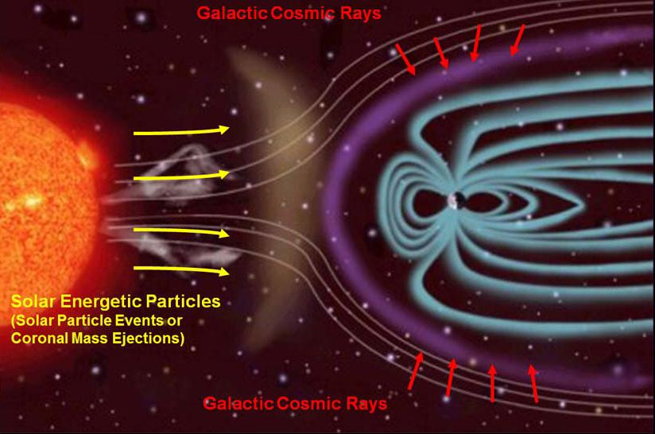
CRP – Mission Outline
Objective – to detect incoming cosmic ray particles and determine their direction and magnitude.
Types of Cosmic Rays:
  Solar
  Anomalous
  Galactic
Notes:
Determine cosmic ray characteristics through image processing of the pixels
Solar Cosmic Rays
Energy Levels: 10⁷ to 10⁸ eV
Origin: Corona of the Sun
Anomalous Cosmic Rays
Energy Levels: 10⁷ to 10⁸ eV
Origin: Ionized neutral interstellar atoms
Galactic Cosmic Rays
Energy Levels: 10¹⁰ to 10¹⁵ eV
Origin: Shocks of supernovas

Slide 5
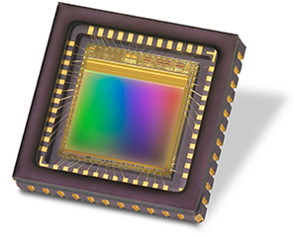
CRP – Sensor and Operation
CMOS Image Sensor
Trigger event – pixels hit by cosmic ray particle
Determine cosmic ray characteristics through image processing of the pixels
Operation
10 5-second exposures with one second between exposures, 5 cycles in one orbit
~8 Mb per data collection cycle
Notes:
Determine cosmic ray characteristics through image processing of the pixels
Solar Cosmic Rays
Energy Levels: 10⁷ to 10⁸ eV
Origin: Corona of the Sun
Anomalous Cosmic Rays
Energy Levels: 10⁷ to 10⁸ eV
Origin: Ionized neutral interstellar atoms
Galactic Cosmic Rays
Energy Levels: 10¹⁰ to 10¹⁵ eV
Origin: Shocks of supernovas

Slide 6
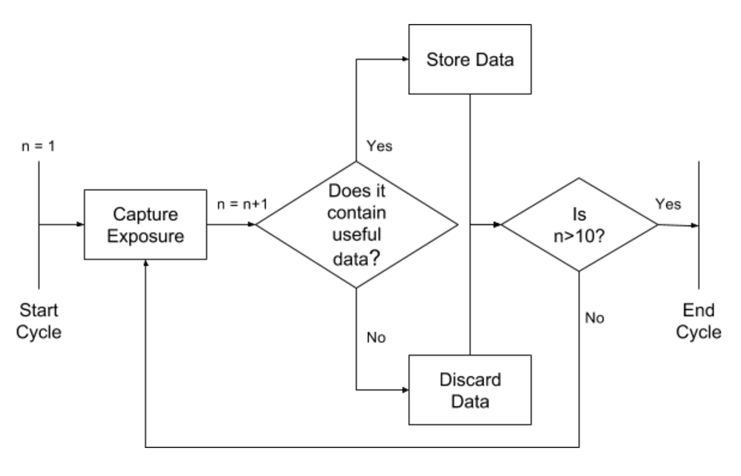
CRP – Cycle Definition

Slide 7
Radiation RAM (RAD RAM)

Slide 8
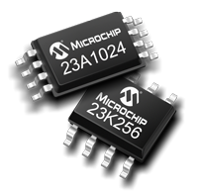
RAD RAM – Mission Outline
Objective – To determine the correlation between radiation and bit flipping in commercial RAM by monitoring flipped bits.
The degradation of memory will be tracked through the detection of false memory writes
Types of RAM:
  Flash
  SRAM
  FRAM
  MRAM
  EEPROM
Notes:
Data Interface: SPI or I2C

Slide 9
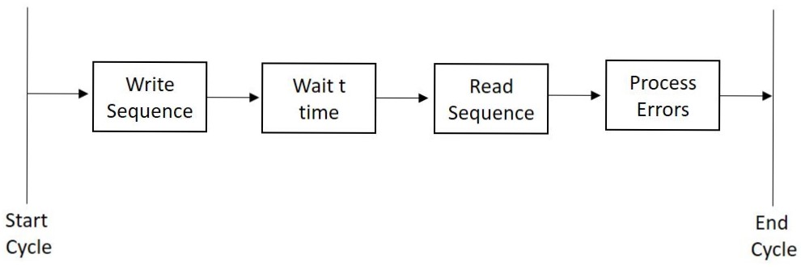
RAD RAM – Cycle Definition

Slide 10
RAD RAM – Software Algorithm
Start
Write test sequence into memory
Wait t time
Read test sequence back from memory
Read Sequence XOR
Test Sequence
Record address of errors
Send errors to OBC for transmission
Write new test sequence into memory
Wait t time

Slide 11
Space Debris Payload (SDP)

Slide 12
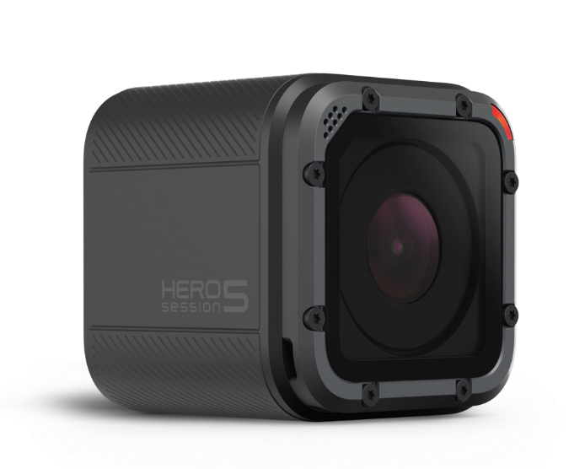
SDP – Mission Outline
Objective – to survey space debris and space dust that is 12 cm and smaller to test current debris estimates.
Image Sensor:
GoPro Hero 5 Session
Detection through the capture of debris streaks
Operation:
5 2-second exposures with one second between exposures
3 cycles per orbit.
~32 Mb per cycle (raw data)

Slide 13
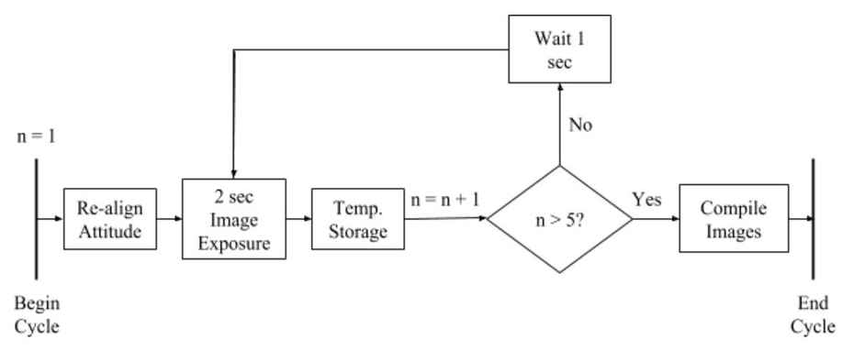
SDP – Cycle Definition

Slide 14
SDP – Removal
Requirements were too demanding
  Pointing / stability requirements
  Data requirements
  Space requirements
  Power* requirements
Design not mature enough:
  On board processing techniques
  Best measurement directions for debris concentrations
Notes:
Requirements too demanding
Pointing / Stability requirements
Data requirements
(Power although not so much)
Space requirements
Design not mature enough (We were still developing):
Debris streak on board processing techniques
Best measurement directions for the debris surveys

